Slide 1
Adult Literacy Awareness for Further Education & Training
Session 3
Literacy Awareness &
Creating a Literacy-Friendly Environment
Notes:
2 minutes
Welcome participants back.
Introduce session 3. In the previous two session, we have looked at some of the theories that are relevant to adult education. We will now begin to broach the broader subject of Literacy Awareness, exploring how we can recognise and address unmet literacy needs and identifying ways in which we can destigmatise the term ''literacy'' for the adult learner.
Before delving into this week's content, we will first take some time to share our experiences and reflections from last week's extension activity.

Slide 2
Extension Activity
Consider the theorists discussed in sessions 1 and 2
Take some time during the week to reflect on any theories discussed that inform your current practice:
Knowles - Andragogy & 6 Assumptions of Adult Learners
Lave & Wenger - Communities of Practice & Situated Learning
Mezirow - Transformative Learning
Maslow - Theory of Motivation & Hierarchy of Needs
Freire - Pedagogy of the Oppressed
Rogers - Experiential Learning & Teacher as Facilitator
How might you incorporate what you have learnt into your future practice?
Notes:
2 minutes
Recap on the extension activity from last week:
Consider the theorists discussed in sessions 1 and 2
Take some time during the week to reflect on any theories discussed that inform your current practice:
Knowles - Andragogy & 6 Assumptions of Adult Learners
Lave & Wenger - Communities of Practice & Situated Learning
Mezirow - Transformative Learning
Maslow - Theory of Motivation & Hierarchy of Needs
Freire - Pedagogy of the Oppressed
Rogers - Experiential Learning & Teacher as Facilitator
How might you incorporate what you have learnt into your future practice?
Feedback can be given visually and verbally on the next slide.

Slide 3
Extension Activity Feedback Theory & Practice
Mezirow
Transformative Learning
Lave & Wenger
Communities of Practice & Situated Learning
Individual
Societal
Rogers
Experiential Learning & Teacher as Facilitator
Freire
Pedagogy of the Oppressed
Knowles
Andragogy &
6 Assumptions of Adult Learners
Maslow
Theory of Motivation & Hierarchy of Needs
Notes:
15 minutes
Using the annotation tool, ask participants to mark one or two of the theorists that resonated with them most.
Take a few minutes of verbal feedback from the group. Did this exercise bring any insights for participants into ways that they are already working? Have it stirred ideas for how participants might adjust how they engage with students and deliver classes from here on?
There should be plenty of space given to participants to share their ideas for how their future practice can be informed by this exercise.

Slide 4
Aims Session 3: Literacy Awareness &
Creating a Literacy-Friendly Environment
Recognise
How to
Useful
Questions to ask
Talk about literacy
Unmet literacy, numeracy, & digital literacy needs and competencies
Create
A literacy-friendly environment
Notes:
1 minutes
In this session, we will identify some of the signs and signals that indicate unmet literacy needs.
We will explore ways that we can talk about literacy both with literacy learners and in wider society, and how we can reframe and destigmatise the term ''literacy''.
The literacy-friendly environment is key to inclusivity and access. We will examine the experience of individuals with unmet literacy needs in accessing services and discuss ways in which we can make our environments and organisations more literacy-friendly.
Finally, we will take an overview of some useful questions to ask of ourselves, our organisations, and of individuals with unmet literacy needs, with a view to carrying out a skills, equipment, and access audit, and understanding the requirements we place on individuals accessing our services.

Slide 5
Recognising Unmet Literacy Needs
Know the signs
Excuses for not writing
Reluctance to fill out form
Writing process laboured and slow
Poor punctuation and/or structure and/or syntax
Incorrect spelling
Use of either all lowercase or all uppercase letters
Watch the body language
May be getting a lot of invisible external support
Notes:
5 minutes
When we begin to look out for the signs of unmet literacy needs, we need to keep in mind that everyone´s needs will vary greatly. People can have a wide variety of coping strategies to manage how they deal in the world day-to-day. This can range from avoidance to evasiveness, rushing or making excuses, being defensive or aggressive or getting someone else to do it for them. ¨I´ve forgotten my glasses¨ is a classic example that is heard repeatedly from students returning to improve their literacy skills. In work settings an individual can be fearful of exposure if they have unmet literacy needs.
Individuals may be embarrassed or wary about details they are required to share in an application or registration form. The person may feel vulnerable and defensive about this. This may be compounded by a lack of confidence in literacy skills and can seriously hamper the ability of the person to engage and progress in education or working life.
Form filling can be a good indicator of literacy skills. Keep an eye out for the use of all upper or lower case letters, exaggeratedly slow and careful writing, confidence in writing name and address but difficulty with further information.
If teaching on an accredited programme, you may see assignment work coming through that is at a far higher standard than you might expect from the individual before you. Some might delegate their work to others. Students with unmet literacy needs can be very good at creating a network of support from those around them.

Slide 6
Recognising Unmet Literacy Needs
Digital Literacy
General mistrust of technology
"My computer / wifi is not working"
Won't cope with receiving anything by email
Confident with smart phone but can't use formal applications
Can't engage with online services, welfare, banking, registration, etc.
Notes:
5 minutes
When we consider the statistics for those with low digital literacy skills in Ireland, approximately 55% as of 2020, and the direct impact of this for individuals trying to engage in day-to-day life, the picture becomes very stark.
Mature students in particular may have a general mistrust of technology due to a lack of confidence or knowledge. A positive aspect of the rise in digital needs is that while confidence may be low, it is often relatively easy for a mature learner to express their lack of digital skills. There is far less stigma attached to digital literacy than to traditional literacies. That said, it can cause incredible anxiety and loss of agency, for example, where an older person can no longer engage with their financial institution, or their healthcare provider.
During the first wave of Covid 19, the Health Service Executive put out communications directing people to view their website for information. It was quickly realised that this means of communication was not accessible to everyone. Lessons were clearly learnt for the subsequent vaccine roll-out, where a simple phone number was made available for people to register.
In a college setting, it may be important to keep in mind that students may have applied/registered for college online, but with a lot of support. It may not be immediately obvious that they do not have good digital literacy skills. Also, the purposes for which we use our digital literacy are broad and varied.
There is often an expectation that ¨digital natives¨ (anyone born after approximately 1980) will be fully digitally literate. It can be incredibly frustrating for a young person who may be confident in using certain apps on their phone to also be expected to know how to use more formal aspects of digital tools, such as touch typing, creating good documents, or using a printer correctly.
Younger people with low digital literacy skills can become angry and defensive when there is an assumption that they have all digital literacy skills at their fingertips, just by virtue of their age.

Slide 7
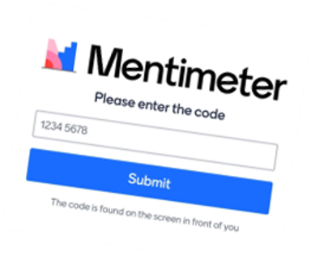
Recognising Unmet Literacy Needs
Considering some of the signs we have discussed for spotting unmet literacy needs.
Have you any real-life examples of how people might hide or cope with their unmet literacy needs?
Notes:
8 minutes
Introduce the Menti, which should take the format of an ¨Open Ended¨ Menti with the question "Considering some of the signs we have discussed for spotting unmet literacy needs. Do you have any real-life examples of how people might hide or cope with their unmet literacy needs?"
Share the Mentimeter.com presentation on screen so that all participants can: (1) see the menti code to enter, and (2) see other participants' submissions.
Give participants the opportunity to discuss their experiences and to comment on similar or contrasting observations that have come up. Facilitators should add any comments that may be important for inclusion and noting.

Slide 8
How to talk about literacy
Literacy is positive
and
empowering
Break the stigma
We all regularly learn new literacies
There is no such thing as "illiteracy"
Notes:
5 minutes
Literacy is always contextual. We are all regularly required to learn new literacies, depending on our environment or experience.
As Digital Literacy permeates how we operate day-to-day, we are continually learning new digital literacies as they evolve. This can be a very leveling for our societal attitudes to of literacy and can put us in the frame of mind of how people may cope with other literacy learnings.
Conversations around "literacy" need to be happening in an open forum and in a positive and accessible way, with empathy and no judgement. It is important to remember what an incredibly positive and empowering thing literacy is. Literacy learners will generally underestimate their abilities. We all have some level of literacy and that should be celebrated when engaging with individuals with unmet literacy needs.

Slide 9
How to talk about literacy
Remember:
Digital Literacy is often the gateway literacy!
Reading and Listening are easier - Receptive Skills
Spelling, Writing, and Speaking are harder - Productive Skills
The stats – you are not alone
Few people are perfect spellers
Adults can tell you what causes them difficulty
New students usually underestimate their skills
Every adult comes with a lifetime of skills and experience
Notes:
6 minutes
When talking about literacy, it can be easier for people to admit that they are not confident with technology and this can be a good starting point to open the conversation around unmet literacy needs. As discussed already, this is particularly true for people who are more mature and did not grow up using digital devices. Counter to this, and as already touched upon, it is important to recognise the digital literacy needs of many younger people. It can be difficult for younger people to admit or even recognise their own digital literacy needs.
When we talk about the more "traditional¨ literacy skills, we are talking about the skills of (1) Reading, (2) Writing, (3) Listening, and (4) Speaking. It can be easier to admit (and indeed true for many) that spelling is difficult, rather than the whole task of writing. A person´s reading skills may be very good, but writing and spelling can be much more challenging for them.
If we think about how we take in information, the skills of Reading and Listening are what we call "Receptive Skills". We are taking in information and decoding it. It takes much less effort to do this than it does to Write or to Speak.
Writing and Speaking are "Productive Skills". When we either write or speak, we are required to produce information. This is much more difficult and can be extremely stressful if we have low confidence in these areas. Think about how often people quell at the thoughts of public speaking. Think about if you have ever learnt a new language. It is much easier to understand it than it is to speak it.
Consider all that we are required to be experts in before we can confidently produce information. If we are writing, we need to be able not only to spell correctly, but to have fluency and accuracy in grammar and syntax, as well as in the topic that we are writing about. Imagine this from the perspective of someone who has a general lack of expertise, has not fluently acquired the English language or the vocabulary of a new workplace, or who has a specific learning difficulty.
When talking about literacy, always keep in mind the statistics: 1 in 6 people have difficulty with traditional literacy skills of reading and writing, 1 in 4 have difficulty with maths, and 55% have low digital literacy skills. Nobody spells everything correctly all the time.
Learning for adults has to be relevant and purposeful. They need to know why they are learning. They also come with a lifetime of experience that can be built upon and transferred to new aspects of learning. People are often very relieved to be able to talk about their unmet literacy needs in a safe and non-judgemental way. They will often hold a lot of stress and greatly underestimate their abilities, feel lost and unsupported in this aspect of their lives.

Slide 10
How to talk about literacy – 1:1
Quiet space with no interruptions
Allow the person plenty of time to relax and speak
Assure confidentiality​
Practice Active Listening ​
Ask open questions ​
Empathise ​
Reassure and offer a pathway
Notes:
6 minutes
It can be difficult to know how to broach the subject of unmet literacy needs with someone that you suspect could benefit from support.
The conversation often starts with recognising a small task that is causing the person difficulty.
It can be very overwhelming for the individual if there is an attempt to address all aspects of unmet literacy needs all at the same time.
For example, a new student in third level may have had a good deal of support throughout their education to date, but now finds that they are all at sea, with a heavy workload to manage. It is important to be in a position to identify any potential struggle that student may have ahead of them. By the time assignments become due, the literacy requirements and workload my be too extreme for the student to cope with. Meeting with failure early on in an academic programme may cause them to drop out and they may never recover the confidence to return to their education in the future. This may apply to purely their formal digital literacy skills.
Pick only one or two very small aspects to talk about initially. Be aware of how you can help and of what supports and pathways exist in your area and community. Staff awareness on literacy support in advance of the academic year commencing and encouraging students to sign up early for support should be normalised in the education setting.

Slide 11
5 Minute Break
Notes:
5 minutes

Slide 12
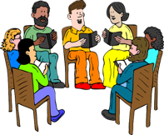
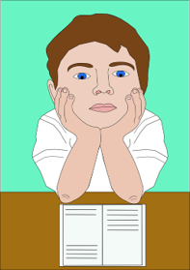
How Literacy Accessible is your centre/service?
Environment
Staff awareness
Reading Material
Verbal Communication
Digital Access
Notes:
8 minutes
Look at your environment through a literacy lens. How accessible is your environment to someone with unmet literacy needs? Who is the person trying to access your service? For example, is it a student or is it their parent? Consider a parent with unmet literacy needs supporting their child to access a third level course. What environment, either physical or digital would allow that parent to effectively support their child?
Is there someone with a good Literacy Awareness at front of house and at the end of a telephone? Speaking with someone face-to-face may be the only way that an individual can effectively engage initially with your service. Will the first staff member that the person meets be able to direct them correctly within your service. For example, if the person attending speaks with a foreign accent, do they immediately get dismissed and told to go to the English Language department regardless of their abilities? How could this be addressed?
In terms of Digital Access, is your website mobile responsive, i.e. can be viewed on a mobile device. Most websites nowadays are mobile responsive, but it can be worth double checking how information appears on both mobile and desktop. What is the User Experience like on your website or social media? Is it easy to find a physical address or directions, telephone number, or name for someone that people can contact? Is it clear, simple and easy to navigate or do you need to create a login? Work on the basis of the three click rule – it should take no more than three clicks to find the information that you need. Is the language and formatting of your digital material clear and easy to make sense of?
Are reading materials created using Plain English? Are they visually easy on the eye and simple to decipher? Is the language clear? Is any necessary jargon or vocabulary explained from the outset.
Is there a good cohort of staff that have engaged in Literacy Awareness training? This is available through your Adult Literacy Service in your local Education and Training Board. Is the topic of Literacy Accessibility discussed in a positive and progressive way throughout your service? This may happen in the form of discussion around Universal Design for Learning. Bear in mind that in educational settings it may be possible to use myriad alternative means to deliver and receive course work, but this does not negate the need for students to be supported in building good traditional literacy skills.
In terms of access and literacy, is there always somebody available to discuss needs and offer effective supports and pathways for individuals? This should not be just one staff member. It should be embedded across your organisation.

Slide 13
Useful questions to ask
What access to communication does your participant have?
Letter box
Button / Smart phone
Tablet / Laptop
Limited Phone data /Wifi / Don't know?
How do you communicate?
Jargon/Vocabulary
Flyers/Leaflets
Videos
Online Resources
Post
Email
Text
WhatsApp – text / voice / video
Other: ________________
What types of communication can your participant use?
Phone (calls only?)
Post
Text
Email (receive – reply – attach?)
Voice Message
Video Message
Self-directed online engagement
Does this inform how your organisation
communicates?
Notes:
7 minutes
Run an audit of what media and styles of communication you and your participants use. Here are some useful questions to ask of yourself, your participants, and your organisation. This list of questions is not exhaustive. There may be other aspects of communication that are not included.
How do you communicate?
Consider explaining or clarifying any jargon or vocabulary that you use.
The information that printed material communicates should be instantly and clearly decipherable. Use images to assist.
Similarly, any written content in a letter, text, or email should use Plain English (which we will talk more about next week) and be clearly laid out.
Videos can be a great way to share information. A good example of using videos to communicate important information is on the LCETB Clare Family Learning Project website at https://familylearning.ie/. They have created very clear information videos for parents about the various milestones in a child´s development. Videos do not necessarily have to be very high quality. Often, a clearly made ¨amateur¨ video can speak more directly to and be more accessible for the viewer.
What access to communication does your participant have?
In asking this, we are thinking about the participant´s physical environment.
If your participant´s home environment is either transient or chaotic, it may be difficult for them to consistently receive post. It is important to sensitively consider and discuss with individuals what access they have to a variety of modes of communication.
Consider also whether of not there may be hearing, sight or speech difficulties for the individual.
What types of communication can your participant use?
Aside from access to various modes of communication, it is imperative to understand the capacity of the individual to use those medium that are available to them.
Many people have smartphones that they can only use for voice calls, but cannot utilise them for messaging or applications.
Just because someone owns a laptop, it does not necessarily follow that they have an email address or are comfortable using the internet.
If the individual has an email address, can they receive emails only, or are they comfortable responding to them also? Can they start an email on their own, or can they only respond? If they can send an email, can they attach a document? This can lead to more questions to find out about the person´s ability to use various applications, such as those in the Microsoft Office or Google suites. You should also learn from the person how they cop with saving and organising documents on their computer or cloud drive.
Does this inform how your organisation communicates?
Once you have taken time to reflect on the Literacy-Accessibility of your communications, it is worth asking whether there are any changes that you can make or that can be made throughout your organisation to improve communication between you and your participants. Ultimately, some small changes can make the world of difference and benefit both the organisation and your participants, either current or prospective.

Slide 14
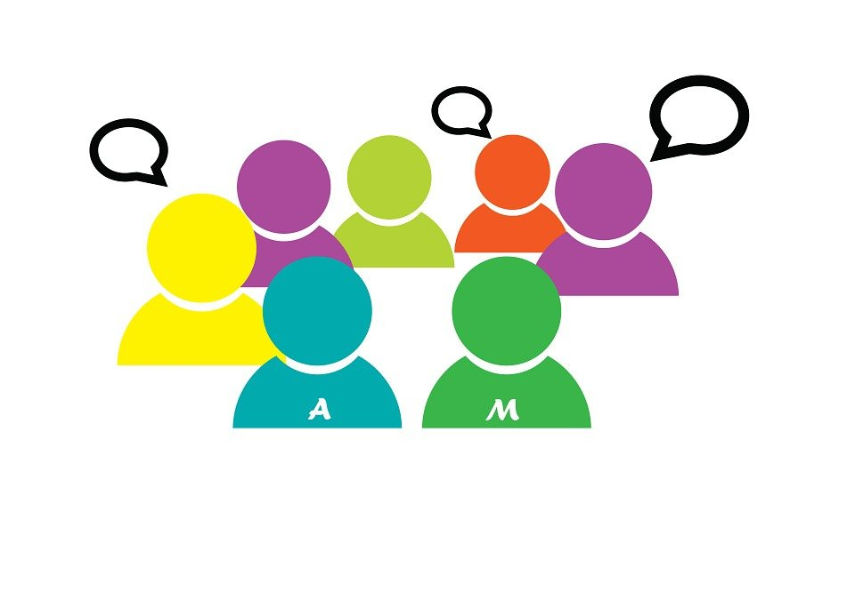
Breakout Room
Think of someone with unmet literacy/digital literacy needs that you have encountered through your work.
What literacies do people need in order to engage with your centre/service?​
Notes:
30 minutes
2 minute Intro
12 minutes in Breakout Room
4 minutes / group x max 4 groups
Introduce the Breakout Room.
Task:
Think of someone with unmet literacy/digital literacy needs that you have encountered through your work. What literacies do people need in order to engage with your centre/service?
Group 4 or 5 participants to each room. It is useful to group participants differently for each break-out room to allow everyone the opportunity to get to know each other. Remind participants not to identify any individuals in their discussions. Groups should identify one person to takes notes and feedback from the task at the end.
Give 10 minutes for discussion, with 2 minutes countdown time for the breakout rooms.
When the breakout rooms close, give 4 minutes to each group to share their feedback and discuss new learning.

Slide 15
What helps
Do a skills check - don't just assume
Use Plain English & clarify necessary jargon
Know what supports are available
Reassure the person you're happy to help
Offer information in more than one format
Above all be patient
Notes:
5 minutes
There are very simple things that we can do to help make our communications more Literacy-Accessible. As discussed already, don´t assume the capabilities of the individual. We deal for the most part with adults. Adult can usually tell you about any challenges they may have, particularly when asked in a gentle, helpful, and open way.
People can quickly feel very isolated if they are receiving information that is incomprehensible to them. Use "Plain English", alternative methods of engagement, and multiple opportunities to reinforce the content in a variety of ways. We will discuss all of these techniques in more detail in further sessions. Keep in mind that, in general, we read less now than we used to, or we read short sound bites. Many people are less practiced in constructing sentences than may have been the case in the past. When delivering a course, include a glossary from the outset, encourage class questions and discussion to familiarise students with the vocabulary and subject matter. Give students the opportunity to become familiar with the style of writing required.
Knowing what supports are available locally can be very empowering both for you and your participants. In Session 4 we will discuss Boundaries and Referral Routes for support from your local ETB Adult Literacy Service. You can always ask your local Adult Literacy Organiser for support for your own practice or any questions or advice that you may have to support or direct your participants. Find out if there is any structure within your own organisation that can offer support too. For example, in the Colleges of Further Education, there may be good support available through the Learning Support Department.
Above all, be patient and reassuring to the person. Be prepared to provide information in a variety of formats, for example, through follow-up conversations, voice recording, a written note with images scribbled in – whatever will best work for the person before you.

Slide 16
What hinders
Difficult to understand / Information overload
Redirecting to online content
Incorrectly directing the person
Dismissiveness
Unfamiliar concepts or subject matter
Irrelevant information
Notes:
4 minutes
We have discussed making information accessible and we will do a deeper dive into this in Session 5. It is important to keep communications clear and relevant. Perhaps most important of all though, is taking the time to properly support the person before you.
When individuals with unmet literacy needs meet with a lack of empathy, dismissiveness or misdirection, this can increase the stress, anxiety, and alienation of the individual. It is likely that we can all reflect on situations in our lives where we have been misdirected or dismissed when seeking support, where a small amount of time invested at the outset to properly support us would probably have benefitted all involved.

Slide 17
Benefits
Trust & confidence
Equal access
Increased participation
Good communication & understanding
Positive impact for person, community & practitioner
Notes:
3 minutes
The enormous value of being literacy-aware and creating a literacy-friendly environment is undeniable when we begin to view the benefits. In truth, all the items listed on the slide are only the tip of the ice-berg. The very real and positive impact for, not only the person with unmet literacy needs, but for their immediate family and their wider community should never be underestimated.

Slide 18
Extension Activity
Considering the following areas:
Environment
Digital access
Reading material
Staff awareness
Verbal communication​
Reflect on three possible adjustments you would
consider to make your organisation/work
more literacy-friendly?​​
Notes:
3 minutes
Introduce the Extension Activity to be practiced between now and the next session.
Task:
Considering the following areas:
Environment
Digital access
Reading material
Staff awareness
Verbal communication
Reflect on three possible adjustments you would consider to make your organisation/work more literacy-friendly?
Remind participants to set aside some time for this practice. Suggest that participants may like to take some notes for sharing on our next session.

