Slide 1
Adult Literacy Awareness for Further Education & Training
Session 2
Theorists &
Causes and Impacts of
Unmet Literacy Needs
Notes:
2 minutes
Welcome participants back.
Introduce session 2. In this session we will be looking at three more theories relating to adult education, and the impacts and causes of unmet literacy needs.
Before delving into this week's content, we will first take some time to share our experiences and reflections from last week's extension activity.

Slide 2
Extension Activity
Visual Feedback
What would your life be like if you
were unable to read or write?
Use the scale to rate how stressful you found the task under 3 headings:
Physical task
Emotional/stress levels
Asking for assistance
Notes:
3 minutes
Introduce the Menti, which should take the format of a ¨Scales¨ Menti, with the question: "Slide the bars across on each line to show how stressful you found the task", and statements (1) Physical task, (2) Emotional/stress level, (3) Asking for assistance.
Share the Mentimeter.com presentation on screen so that all participants can: (1) see the menti code to enter, and (2) see the scales alter as participants submit their input.
Use the scale to rate how stressful you found the task under 3 headings:
Physical
Emotional - stress
Social - Asking for assistance
Take a little time to observe the overall feelings of the group as submitted. The next slide will allow more time for everyone to discuss their experiences.

Slide 3
Extension Activity
Verbal Feedback
Q. What would your life be like if you were unable to read or write?
What activities did you carry out during the literacy-free period?
What obstacles did you encounter?
Strategies used to overcome obstacles?
How did people respond to you?
How did you feel?
Anything else you would like to share?
Notes:
10 minutes
Give participants the opportunity to discuss and share their experience of the extension activity. What approach did they take to the activity? Did they practice it during the work day or during leisure and family time?
Run through some of the questions on the slide as prompts to discussion. There won't be time to hear from everyone, but there should be a good opportunity to get a sense of shared or divergent experiences between participants.
Allow space for participants to reflect and share without too much interruption from the facilitators.

Slide 4
Aims Session 2: Theorists & Impacts and Causes
of Unmet Literacy Needs
Explore
Theories relevant to adult literacy education
Impacts of unmet literacy needs
Identify
Causes that lead to unmet literacy needs
Discuss and reflect
Your awareness of individuals with unmet literacy, numeracy and digital literacy needs
Overview
Notes:
2 minutes
In this session, we will explore three more theories relevant to adult literacy education. We will also be delving into the impacts and causes of unmet literacy needs for individuals and their wider communities.
We will also begin to reflect on and discuss real-life experiences where we have been aware of individuals with unmet literacy needs.

Slide 5
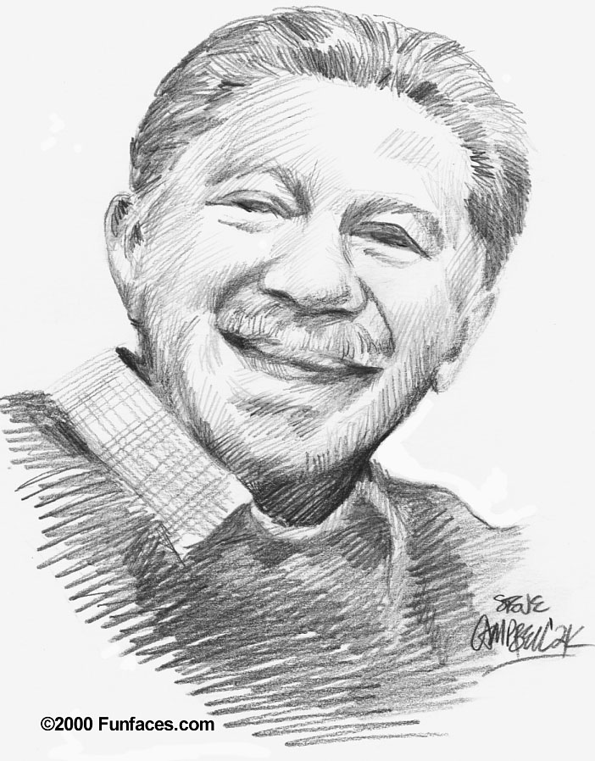
Abraham Maslow
Theory of motivation​
​
Maslow set out to investigate the characteristics ​of the
fully-rounded, healthy personality. From ​this he developed
a theory of motivation in which​ he set out to describe the
powerful goals which ​drive people’s behaviour.
This is known as Maslow’s ‘hierarchy of needs’ and it describes five sets of needs:
(1) Physiological, (2) Safety, (3) Love, (4) Esteem and (5) Self-actualisation. ​
Notes:
3 minutes
Abraham Maslow is an American psychologist widely known for his Theory of Motivation, which he published in the 1940s. This theory introduces us to the very recognisable pyramid of Maslow's Hierarchy of Needs.
There are five needs that Maslow establishes as being required for a fully-rounded and healthy personality:
Physiological
Safety
Love
Esteem
Self-actualisation

Slide 6
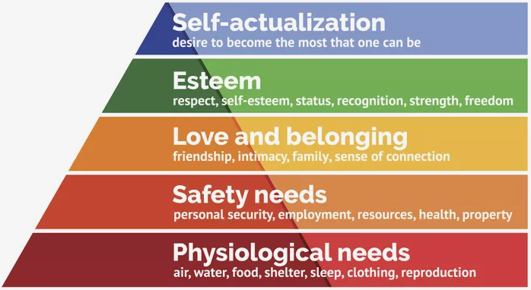
Breakout Room
Consider someone you have encountered whose learning was impacted by unmet needs somewhere on this hierarchy.
Discuss the impact it had on the person's learning.
Notes:
30 minutes
3 minute Intro
12 minutes in Breakout Room
3 minutes / group x max 5 groups
Introduce the Breakout Room.
Task:
Consider someone you have encountered whose learning was impacted by unmet needs somewhere on this hierarchy. Discuss the impact it had on the person.
Group 3 or 4 participants to each room. It is useful to group participants differently for each break-out room to allow everyone the opportunity to get to know each other. Remind participants not to identify any individuals in their discussions. Groups should identify one person to takes notes and feedback from the task at the end.
Give 10 minutes for discussion, with 2 minutes countdown time for the breakout rooms.
When the breakout rooms close, give 3 minutes to each group to share their feedback and discuss new learning.

Slide 7
Impact of Unmet Needs
on the Learner
When our basic needs are not met, it can be very difficult to participate and learn.
Awareness of this supports teachers/facilitators to make allowances during stressful periods for the learner, for example,
Precarious housing situations – homelessness has increased amongst learners
A learner may not have the resources - financial, digital or familial, to fully participate and progress
For literacy learning, sometimes learner attendance is enough in itself
Notes:
3 minutes
Following on from the Breakout Room, there should be plenty of real-life examples from participants of where impacts of unmet needs affected their learners. Take a few minutes to outline any items that may usefully be included.
It is important to note that, in Adult Literacy Services, it may be sufficient for the learner to be in attendance. Learning may be secondary. The person may have to overcome other unmet needs, or begin to feel secure in the learning setting before addressing their literacy needs.

Slide 8
5 Minute Break
Notes:
5 minutes

Slide 9
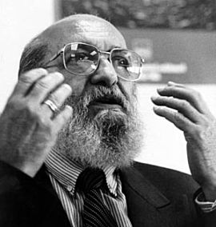
Paolo Freire
Pedagogy of the Oppressed
Raising of consciousness: the purpose of adult education
Dialogue: teacher and learner together reflect, create knowledge, leading to conscientisation
Transformation: of thinking, and then action
Notes:
5 minutes
Paolo Freire was a Brazilian educator and philosopher. His book Pedagogy of the Oppressed was first published in the late 1960s.
For Freire, adult education is always about raising consciousness, first transforming thinking, and then moving to action. This happens through dialogue between the teacher and the student, who are in an equal relationship with each other. His theory proposes that education should allow the oppressed to regain their sense of humanity and retaliates against the dehumanisation of people through systems of injustice, exploitation and oppression.
* Ref. Handout

Slide 10
Paolo Freire
The Banking Concept of Education
The following ideas obstruct conscientisation:
Teacher has all knowledge and power
Learner is an empty vessel – helpless, dehumanised
Teacher transfers knowledge to learner
Knowledge is a ‘thing’ (reification of knowledge)
Notes:
3 minutes
Freire rejects the "Banking" model of education, where the student is treated as an empty vessel that knowledge is simply poured into. This model is undemocratic and there is a power imbalance in favour of the teacher. The student is objectified and dehumanised.
* Ref. Handout

Slide 11
Paolo Freire
Notes:
10 minutes
Play this five minute video outlining Freire's Theory of Critical Pedagogy. It also explores Freire's early life, which greatly influenced his philosophy and practice.
Take time to discuss aspects of the video.
The ethos and foundations from which adult literacy practitioners work with students is always grounded in the equal and mutually respectful relationship between the teacher and the student, as outlined in the video.
Do any aspects of this approach resonate with participants, either from their own learning or in their teaching practice and delivery?
* Ref. Handout

Slide 12
Discussion
What do you think the differences are between a teacher and a facilitator?
Notes:
8 minutes
In discussing the differences between a teacher and a facilitator, encourage participants to share ideas and experiences they have had of good facilitation, as opposed to teaching.
The session facilitators should add any comments that may be important for inclusion and noting.
Ideas for good facilitation may include:
Creates a safe space with healthy boundaries
Encourages students to open up and express themselves
Asks open questions and encourages shared learning from the group
Does not have all the answers
Patient
Positive
Encouraging
Keeps the aims of the exercise in sight

Slide 13
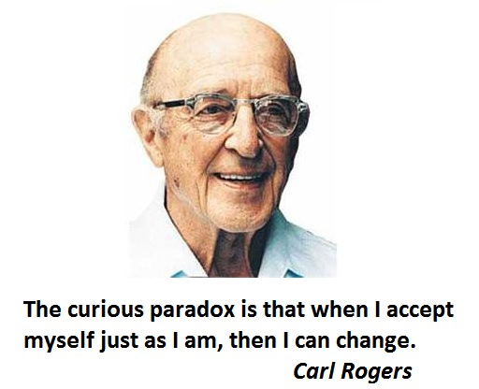
Carl Rogers
Experiential Learning (client-centred approach)
The purpose of education is to produce personal change and development in the whole person, and not just “from the neck up"
Tutor as facilitator
The role of the teacher is therefore not as an imparter of knowledge, but as a facilitator of learning.
Notes:
5 minutes
Carl Rogers was an American psychologist. He developed the "person-centred approach" that is widely used in areas such as psychotherapy and education.
It was Rogers' thesis that a person cannot teach another person directly, but can only facilitate another's learning. He recognised that it can be difficult to take on board learning that will require us to change our worldview. He notes that gently encouraging open-mindedness helps the student to engage in this type of learning.
* Ref. Handout

Slide 14
Impact of unmet
literacy needs
NALA Literacy for life 2020
Notes:
3 minutes
Unmet literacy, numeracy, and digital literacy needs impact on every aspect of life: (1) family life, (2) work life, (3) health and wellbeing, and (4) social and community life.
Take a few minutes to discuss aspects of the image, providing some examples of how unmet literacy needs may affect, for example, the individual's ability to vote, access healthcare information, or help their child with homework.

Slide 15
Impact of unmet literacy needs
Log onto menti.com
Insert code at top of shared screen
"Consider the impact of unmet literacy needs on the individual.
What words come to mind?"
Notes:
5 minutes
Introduce the Menti, which should take the format of an ¨Word Cloud¨ Menti with the question "Consider the impact of unmet literacy needs on the individual. What words come to mind?"
Share the Mentimeter.com presentation on screen so that all participants can: (1) see the menti code to enter, and (2) see other participants' submissions.
Give participants the opportunity to talk about their ideas and to comment on similar or contrasting observations that have come up. Facilitators should add any comments that may be important for inclusion and noting.

Slide 16
Impacts of unmet literacy needs on the individual
Social and emotional
Practical
Felt panic in situations involving reading /writing/digital/numeracy skills
Felt inferior, a sense of failure
Fear others would think they were stupid
Became shy or withdrawn
Maintains defensive barriers
Felt bitter/angry/depressed/hurt
Experienced poor self-esteem
Negative attitude to education
Difficulty reading or writing a letter or fill in forms,
Struggle with Social Media, text messaging, email
Unable to express an opinion in public
Not applying for jobs or taking up promotions
Experiencing anxiety/failure when required to participate on a course
Problems ordering a meal/shopping/reading a label
Notes:
3 minutes
This slide looks at various ways in which unmet literacy needs impact on the individual, both practically, and on a social and emotional level.
Participants may have come up with other impacts during the Menti discussion.
Allow space for questions or observations.

Slide 17
Impacts of unmet literacy needs on Family, Community and Society
Students have reported that they:
Avoid travelling outside their comfort zones
Could not help children with homework
Experienced tension or imbalance in their relationships
Feel held back on their relationships with their children
Could not read stories to their children
Held back from taking an active role in clubs/community groups or local activities
Less likely to vote
Notes:
3 minutes
This slide looks at various ways in which unmet literacy needs of the individual impact on their family, community, and wider society.
Participants may have come up with other impacts during the Menti discussion.
Allow space for questions or observations.

Slide 18
Traditional Causes of Unmet Literacy Needs
Intergenerational literacy issues
No help with homework
Undiagnosed specific learning difficulties
Undetected issues with sight / hearing
Lack of support/ resources
Poor attendance
Left school early for work/family
Harsh Discipline
Difficult home life
Notes:
5 minutes
There are such a broad and varied range of reasons why a person may have unmet literacy needs. The reasons outlined on this slide are just a few suggestions.
It is worth keeping in mind that learners often blame themselves or think that there is something wrong with them, even when they have missed out on their education for very important reasons, for example, to look after younger family members or to start working to bring money into the home.
It is also important to note that some learners returning to education after a gap can put themselves under huge pressure to make up for lost time. This is particularly true of people in recovery from addiction. It is important to encourage these types of students to take their time and to put achievable goals in place, to ensure they start their learning journey with the best chance for success.
Given the increasing requirement for digital literacy, it is foreseeable that access to digital resources and skills within the home will become an emerging cause for unmet literacy needs in coming years.

Slide 19
Theorists
Mezirow
Transformative Learning
Lave & Wenger
Communities of Practice & Situated Learning
Individual
Societal
Rogers
Experiential Learning & Teacher as Facilitator
Freire
Pedagogy of the Oppressed
Knowles
Andragogy &
6 Assumptions of Adult Learners
Maslow
Theory of Motivation & Hierarchy of Needs
Notes:
6 minutes
By way of recap and in preparation for introducing the extension activity, spend a few minutes reviewing the six theorists covered in sessions 1 and 2.
While there are elements of cross-over between the theorists discussed, note how the Knowles, Mezirow, and Rogers all speak to the internal process of learning for the individual, while Maslow, Lave & Wenger, and Freire look to the shared learning that takes place amongst social groups. All hold importance in informing our practice as adult education practitioners.

Slide 20
Extension Activity
Consider the theorists discussed in sessions 1 and 2
Take some time during the week to reflect on any theories discussed that inform your current practice:
Knowles - Andragogy & 6 Assumptions of Adult Learners
Lave & Wenger - Communities of Practice & Situated Learning
Mezirow - Transformative Learning
Maslow - Theory of Motivation & Hierarchy of Needs
Freire - Pedagogy of the Oppressed
Rogers - Experiential Learning & Teacher as Facilitator
How might you incorporate what you have learnt into your future practice?
Notes:
4 minutes
Introduce the Extension Activity to be practiced between now and the next session.
Task:
Consider the theorists discussed in sessions 1 and 2
Take some time during the week to reflect on any theories discussed that inform your current practice:
Knowles - Andragogy & 6 Assumptions of Adult Learners
Lave & Wenger - Communities of Practice & Situated Learning
Mezirow - Transformative Learning
Maslow - Theory of Motivation & Hierarchy of Needs
Freire - Pedagogy of the Oppressed
Rogers - Experiential Learning & Teacher as Facilitator
How might you incorporate what you have learnt into your future practice?
Remind participants to set aside some time for this practice. Suggest that participants may like to take some notes for sharing on our next session.

