Slide 1
ETBI/ETB Module Re-design/Update Project
Module Development for QQI CAS Awards for ETB Curriculum Development Support Staff

Slide 2
Plan for the day
10.00 – 10.15 | Welcome & overview of the session Introduction to the Resource Bank Relevant FESS upcoming PD events
10.15 – 10.45 | Working with subject-matter experts Sharing Expertise
10.45 – 11.00 | Exploring our educational values and beliefs
11.00 – 11.15 | Break
11.15– 13.00 | Writing module learning outcomes for selected modules leading to CAS minor award/s Activity
13.00 – 14.00 | Lunch
14.00 – 15.00 | The principle of constructive alignment Selection of assessment techniques The development of assessment guidelines Activity
15.00 – 16.00 | Devising assessment criteria Activity

Slide 3
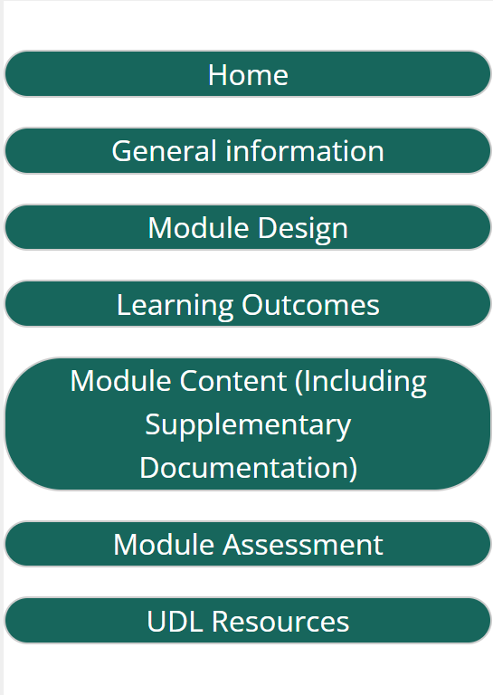
ETBI Digital Library
Resource Bank

Slide 4
ETBI Digital Library
Resource Bank
Notes:
UDL approach
Tips document

Slide 5
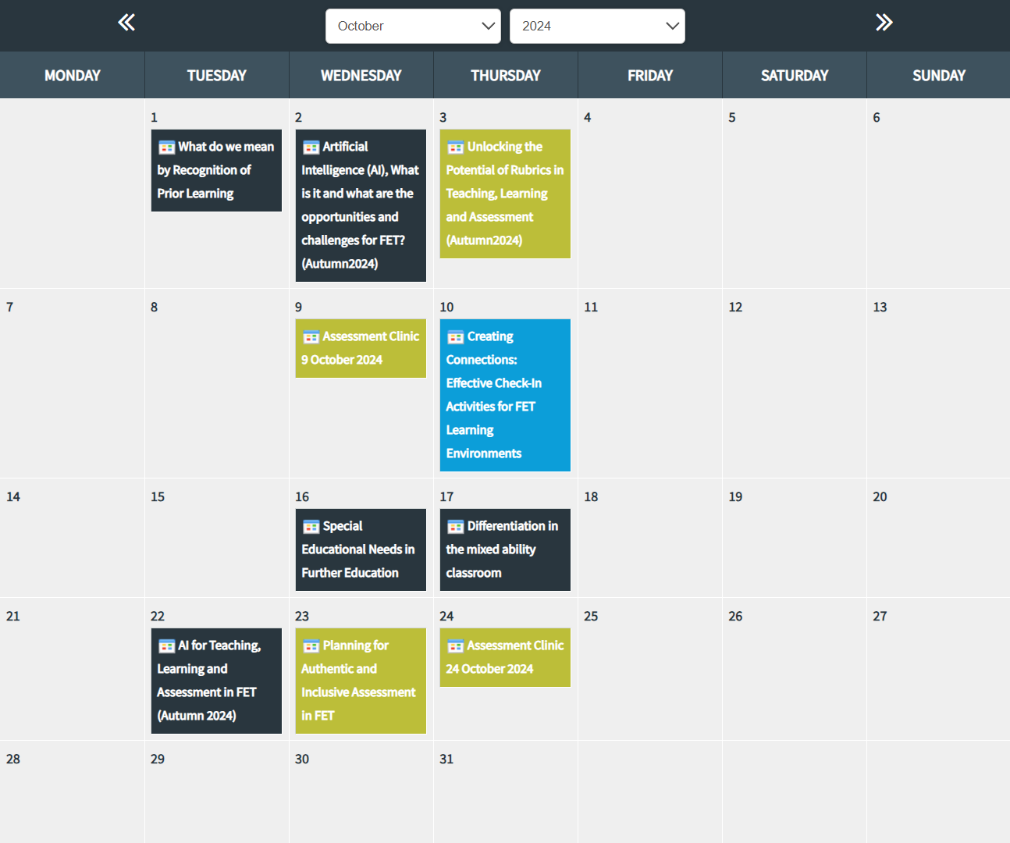
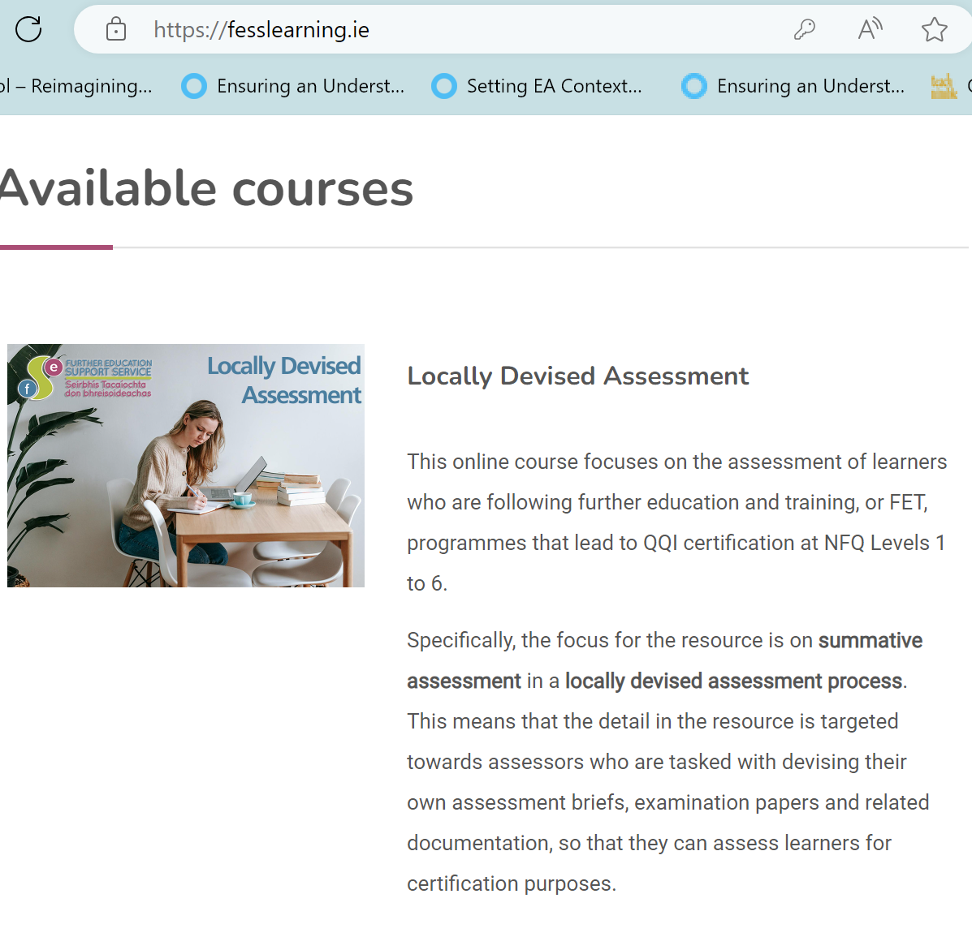
Some upcoming FESS PD events…

Slide 6
Reflecting on the Process
Case Studies
David Crowley, MSLETB
Niamh Gaine, Cork ETB
Fiona Fay, DDLETB

Slide 7
David Crowley
MSLETB

Slide 8
Being an SME
Your SME might have zero programme development experience
Hopefully might have completed UDL badge
Our role is to guide them
They will not bring “perfect” Learning Outcomes to you
Key Questions (for me)
Is that learning outcome assessable?
How would you assess that learning outcome (s)
Is it measurable?

Slide 9
Manage Expectations
Outline what is possible – Component Spec Vs Module Descriptor
Timelines
Meeting Schedule
Availability of the SME

Slide 10
Leader Vs Manager
You are probably not the SME’s line manager

Slide 11
Programme Development Story
Level 6 Certificate in Music Level 6 Certificate in Digital Media Production
Niamh Gaine - Assistant Manager, Cork College of FET- Bishopstown Campus

Slide 13
Reflecting on the Process
Case Studies
David Crowley, MSLETB
Niamh Gaine, Cork ETB
Fiona Fay, DDLETB

Slide 14
Reflecting on the Process
Case Studies
David Crowley, MSLETB
Niamh Gaine, Cork ETB
Fiona Fay, DDLETB

Slide 15
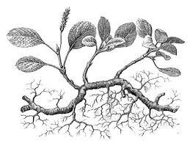
Programme Development is a Rhizomatic Process

Slide 17
Fiona Fay
DDLETB

Slide 18
Working in curriculum support with SMEs: learning to date Fiona Fay, DDLETB
Respect for both roles: both bring necessary contributions … neither is expected to know everything
Bring a framework with flexibility … sketch out … iterative
Need to deliver: important to lead in managing the pace, ensuring good practice, version control
Steering group model has worked well … keep it simple
Opportunity to develop relationships and acknowledge common goals … the learner is at the centre of what we do

Slide 19
Exploring our Beliefs and Values
Geraldine O’ Neill, UCD, 2015, Curriculum Design in Higher Education: Theory to Practice
Chapter 3 Needs Analysis and Educational Philosophy pp. 16 - 24
The starting point of a programme design is;
b) The development and articulation of a set of values and beliefs that the programme team aspire to , ie. A programme educational philosophy
Dialogue and articulate individual educational and subject / discipline / professional values
Negotiate and agree a shared vision and some common values
This will inform a more coherent choice and sequence of programme outcomes, content , teaching, learning and assessment approaches in the programme

Slide 20
Exploring our Beliefs and Values
Define a set of values and beliefs that the programme team aspire to … Peter De Witt (founder and CEO of Instructional Leadership Collective
- Your core beliefs and values / Why you got into education in the first place?
‘’We should always evolve in our beliefs, but we should never lose sight of why we entered into education in the first place’’

Slide 21
Some prompts for reflection
One of the things that is most enjoyable about education is ... How do learners learn? ... How can I support them? A learning environment ought to be ... Why Assess ? How to Assess ? ... | Inclusion in FET looks like ... If I could change one thing in FET I would ... What is the purpose of FET ? ... I am an educator. This means my role involves ... Education matters because ... Why am I an educator ….. ?
Professional Development prompts, National Forum for Teaching and Learning eZine and Centre for Teaching and Learning MU

Slide 22
3 Beliefs
What are 3 core beliefs / values you would
defend about learners ,
learning and/or education?
Relevant Actions
Distractions
LEARNERS
Team Beliefs / Values
www.petermdewitt.com

Slide 23
3 Beliefs
What are 3 core beliefs / values you would
defend about learners ,
learning and/or education?
Relevant Actions
Distractions
- Write LOs that ensure inclusiveness / adhere to principles of UDL
Inclusion
- Copy LOs from the old module descriptor
LEARNERS
Team Beliefs / Values
www.petermdewitt.com

Slide 24
Writing module learning outcomes for selected modules leading to CAS minor award/s

Slide 25
Some context…
QQI CAS Minor Awards
1315 minor awards on the QQI database
Some include out-of-date and/or irrelevant learning outcomes
Some assessment techniques may no longer be the optimum method for assessing learner achievement
Scope for providers, under their QA governance structures to:
Develop new module learning outcomes, while demonstrating consistency with the linked CAS standard(s)
Determine new, more relevant assessment techniques for programme modules
Notes:
Current focus is on small number of modules

Slide 26
The key word for today is…
Consistency

Slide 27
Consistency…
…
Award Standards
Assessment Guidelines
Teaching & Learning Methodologies
Assessment Criteria
Teaching & learning Resources
Content
Learning Outcomes
Consistency
Consistency
Consistency
Consistency

Slide 28
Modules – Key Elements
Learning Outcomes
QQI award standards
Content
Teaching & Learning Methods & Resources
Summative Assessment
Text
Notes:
Learning outcomes outline what the learners will be able to do at the end of the programme
These are determined by and consistent with the award standard
Appropriate content activities and tasks need to be identified that will bring the learners from where they are to the point where they can demonstrate achievement of the learning outcomes
Appropriate teaching and learning methods and resources need to be identified, thinking about whether the teaching and learning tasks and activities and approaches are valid in that those chosen approaches are the best option for imparting the knowledge, skills and competence that the learner will need to acquire to demonstrate achievement of the learning outcomes
Who are your learners, you may have to consider different teaching and learning methods depending on the learner profile
How are you going to know whether the learner is able to demonstrate the learning outcomes? The summative assessment activities and processes needs to be consistent with the LOs and the content. The assessment activities need to be valid, reliable, fair, transparent and quality assured and most importantly should allow the learners demonstrate what is required of the LOs.

Slide 29
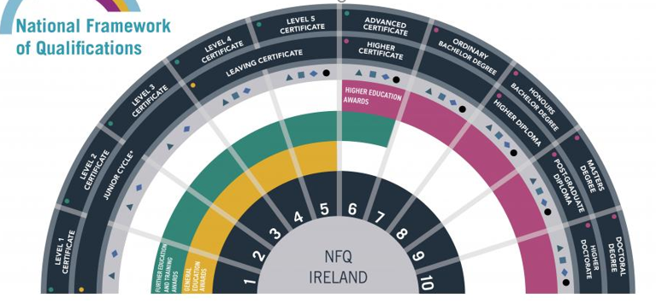
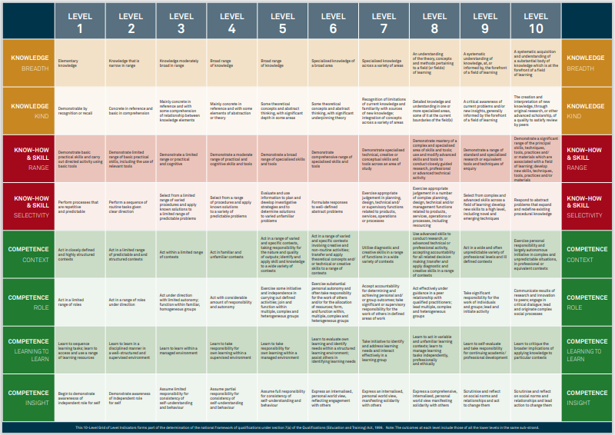
NFQ Grid of Level Indicators
https://www.qqi.ie/sites/default/files/2021-11/nfq-grid-of-level-indicators.pdf
Notes:
This should be your best friend as it allows you to pitch the LOs, content and assessment at the appropriate level. It is useful also to look at the level below and above

Slide 30
Synopsis of Level Outcomes: NFQ Levels 3, 4, 5, 6 and 7
Level 3 | Level 4 | Level 5 | Level 6 | Level 7
Learning outcomes at this level relate to: a low volume of practical capability and of knowledge of theory the performance of relatively simple work and may be fairly quickly acquired minimum employability for low skilled occupations and include functional literacy and numeracy. | Independence is the hallmark of this level. Learning outcomes at this level: correspond to a growing sense of responsibility for participating in public life and shaping one’s own life are associated with first-time entry to many occupational sectors. | Learning Outcomes at this level: Include a broad range of skills that require some theoretical understanding relate to engaging in a specific activity, with the capacity to use the instruments and techniques related to an occupation are associated with work being undertaken independently, subject to general direction. | Learning outcomes at this level relate to: a comprehensive range of skills that are vocationally specific and/or of a general supervisory nature detailed theoretical understanding a particular focus on learning skills working in a generally autonomous way to assume design and/or management and/or administrative responsibilities | Learning outcomes at this level relate to: knowledge and critical understanding in a field of study application of those principles in different contexts knowledge of methods of enquiry the ability to critically evaluate different approaches to solving problems. understanding of the limits of the knowledge acquired and how this influences analyses and interpretations in a work context the upper end of many technical occupations, some restricted professionals and junior management.

Slide 31
What information do I need to know or have before starting to redevelop a programme module?
Clarity on your role and the process
Relevant QQI component specification(s)
Relevant validated programme module
Relevant programme module template
Information on how to approach and develop the various elements
Aim/Purpose
Objectives
Learning Outcomes
Assessment
Content including supplementary content
Teaching and learning methodologies and resources

Slide 32
Some thoughts about context
Consider the diversity of the learners that may undertake the module and the variety in learners’ approaches to learning and their stages of intellectual development
Consider how you will acknowledge this diversity and exploit it in positive ways to enhance the learning experience of all learners
Think about the wider contexts within which the design and delivery of module(s) occur and identify any potential current issues within these contexts.
Within your own ETB and across other ETBs
Industry needs - What are the current knowledge, skill and/or competence do employers expect from graduates of the programme of which the module is a part?
National/International

Slide 33
Writing Module Outcomes
MIMLOs
Minimum Intended Module Learning Outcomes

Slide 34
Learning Outcomes – what are they?
“A statement of what a learner knows, understands and is able to do upon completion of a learning process”
European Commission, 2008, Adoption of the European Qualifications Framework
You need to write MIMLOs for each module using precise action verbs, e.g. The learner will be able to:
Describe…
Analyse…
Interpret…
Demonstrate…
Examine…
Reflect…
Construct…
Assess…
etc.
N.B Avoid ambiguous verbs such as know, understand, enjoy, become familiar, be aware of, appreciate, etc.
Text

Slide 35
Learning outcomes must be …
Clearly focused on the target learners
Easily understood by learners and other stakeholders
Consistent with the relevant QQI CAS award standards
Assessable
Learners must successfully demonstrate, through assessment, the achievement of the learning outcomes before they can achieve certification in the award(s)
MIMLOs must be mapped to the assessment techniques for the module
Text
Notes:
Be aware of all the types of learners who are likely to undertake the course. You or the subject matter experts might only have experience of full time provision with 19-20 year olds, whereas across the ETB, this module may be delivered to all sorts of learners on different programmes and different types of provision, part-time, day or evening provision, block release, etc
Care with the language so that any stakeholder should be able to understand what the learning outcome means, so clear and straightforward learning outcome are important
Consistency with the award standard is crucial.
It must be possible to assess the learning outcomes. Care needs to be taken that the way the LO is worded allows for them to be assessed, so the verb is very important because ultimately the learners need to be able to demonstrate achievement of the learning outcome in order to get the award and the Learning outcomes will all be mapped to an assessment task or technique

Slide 36
Learning Outcomes…
Developed by the provider
Consistent with the learning outcomes in the award(s)
Focus on the learning and learner – The learner will …
Focus on the essential knowledge, skills, competence that the learner must demonstrate, through assessment, to achieve certification
Be assessable
Be broad – avoid being too specific – avoid use of “to include” or “including”

Slide 37
Learning Outcomes
Active Verb
Object of the verb
A phrase that gives the context
The learner will be able to…
Apply all necessary health and safety rules and regulations when working in a farm environment, under supervision

Slide 38
Writing Learning Outcomes
Action Verb | Object of the verb | Indication of the context
Keep it simple; avoid overly complex statements
Start each learning outcome with an action verb
Follow with the object of the verb
Complete with an indication of the context
Examples, the learner will be able to:
Engage in critical reflection to support the development of professional practice
Explain how to use a broad range of relevant reports to track company expenses
Apply fundamental conflict resolution practices in the workplace
List the steps involved in patient assessment, including procedures for specific tests.
Text

Slide 39
Verbs Drive Action!

Slide 40
Bloom’s Taxonomy
Important theoretical influence on learning outcomes
Original - Benjamin Bloom, 1956
Revised - David Krathwohl and Lorin Anderson, 2001.
Learning outcomes can specify behaviour in one of three of the following domains:
Text
Cognitive (Thinking):
Knowledge, mental skills, thinking, reasoning understanding, evaluating, applying
Affective (Feeling):
Attitudes, growth in feelings, emotions, values
Psychomotor (Doing):
Manual and physical skills, hand-eye co-ordination, movement

Slide 41
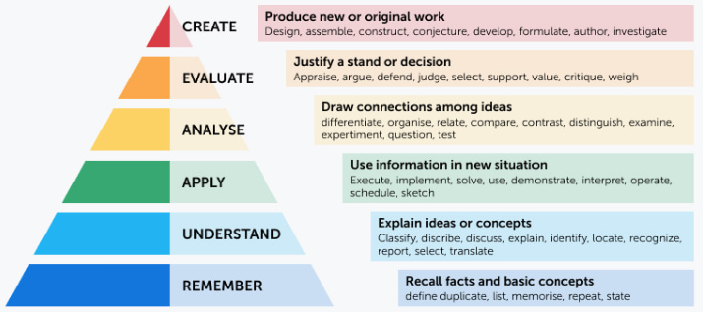
Cognitive Domain (Think): Bloom’s Taxonomy (Revised)
https://www.valamis.com/hub/blooms-taxonomy
Text

Slide 42
Affective Domain (Feel): Bloom’s Taxonomy
Category | Examples of action verbs
Characterisation (internalises values; has a value system that controls behaviours) | Discriminate, display, influence, modify, act, solve, qualify, verify
Organisation (accepts different viewpoints and builds them to develop new perspectives and understanding; resolving conflicts between differing values and creating a unique value system) | Compare, relate, synthesise,
Valuing (shares perspectives while respecting diverse opinions; ability to solve problems | Demonstrate, initiate, invite, justify, propose, respect, share, cherish
Responding (attend and react to a particular phenomenon; questions new ideas and concepts) | Answer, respond, assist, aid, comply, conform, discuss, perform, help, present
Receiving (awareness, willingness to listen, selected attention) | Acknowledge, ask, listen, follow, give
Text

Slide 43
Psychomotor Domain (Do): Dave’s Taxonomy (1975)
Category | Examples of action verbs
Naturalisation (mastering a high level performance with actions becoming second nature) | Create, design, develop, invent, manage
Articulation (several skills can be performed in a harmonious way) | Adapt, construct, combine, create, customise, modify, formulate
Precision (performance becomes more expert and actions are more precise) | Calibrate, demonstrate, master
Manipulation (able to perform certain actions by memory or following instructions) | Act, build, execute, perform
Imitation (observing and copying behaviour after someone else) | Copy, follow, mimic, repeat, replicate, reproduce
Text

Slide 44
Possible Approach…(clustering approach)
MIMLO 1
MIMLO 2
CAS Component
CAS LO
CAS LO
CAS LO
MIMLO 3
CAS LO
CAS LO
CAS LO
CAS LO
CAS LO
CAS LO
CAS LO
CAS LO
CAS LO
MIMLO 4
CAS LO
CAS LO
MIMLO 5
CAS LO
Redundant?
Out-of-date?
Inappropriate?
Content or assessment info?
New

Slide 45
Possible Approach…(blue sky approach)
Key knowledge, skill or competence
Topic
MIMLO
Text
Key knowledge, skill or competence
Topic
MIMLO
MIMLO
Purpose of the Award
Key knowledge, skill or competence
MIMLO
Topic
MIMLO

Slide 46
Working through an example…

Slide 47
Word Processing 5N1358
Text
Credit Value: 15
Purpose: The purpose of this award is to equip the learner with the knowledge, skill and competence to use a word processing application to produce documents in a variety of contexts to a mailable or publishable standard whilst working autonomously and under general direction
Create publishable documents
Modify existing documents
Manage files and their distribution

Slide 48
Learning Outcomes
Active Verb
Object of the verb
A phrase that gives the context

Slide 49
Word Processing 5N1358
NFQ Grid of Level Indicators: Level 5
Broad range of knowledge
Some theoretical concepts and abstract thinking, with significant depth in some areas. Some underpinning theory
Demonstrate a broad range of specialised skills and tools
Evaluate and use information to plan and develop investigative strategies and to determine solutions to varied unfamiliar problems
Act in a range of varied and specific contexts, taking responsibility for the nature and quality of outputs; identify and apply skill and knowledge to a wide variety of contexts
Exercise some initiative and independence in carrying out defined activities; join and function within multiple, complex and heterogeneous groups
Learn to take responsibility for own learning within a managed environment
Assume full responsibility for consistency of self- understanding and behaviour
NFQ Grid of Level Indicators: Level 5
Broad range of knowledge
Some theoretical concepts and abstract thinking, with significant depth in some areas. Some underpinning theory
Demonstrate a broad range of specialised skills and tools
Evaluate and use information to plan and develop investigative strategies and to determine solutions to varied unfamiliar problems
Act in a range of varied and specific contexts, taking responsibility for the nature and quality of outputs; identify and apply skill and knowledge to a wide variety of contexts
Exercise some initiative and independence in carrying out defined activities; join and function within multiple, complex and heterogeneous groups
Learn to take responsibility for own learning within a managed environment
Assume full responsibility for consistency of self- understanding and behaviour
Create a broad range of publishable and specific documents using up–to-date software, tools and skills
Create publishable documents
Text
Modify a broad range of documents using up-to-date software to demonstrate a specialised knowledge and use of word processing features, functions and tools
Modify existing documents
Apply word processing file management and distribution features using appropriate software, skills and tools
Manage files and their distribution

Slide 50
Mapping MIMLOs to the (13) award learning outcomes
Draft MIMLOs | Learning Outcomes from QQI Component Specification
Create a broad range of publishable and specific documents using up –to-date software, tools and skills | LO2, LO3, LO4, LO5, LO7, LO8, LO10, LO11, LO12
2. Modify a broad range of documents using up-to-date software to demonstrate a specialised knowledge and use of word processing features, functions and tools | LO2, LO5, LO7, LO9, LO11
3. Apply word processing file management and distribution features using appropriate software, skills and tools | LO2, LO6
Text
No obvious mapping for LO1 or LO13

Slide 51
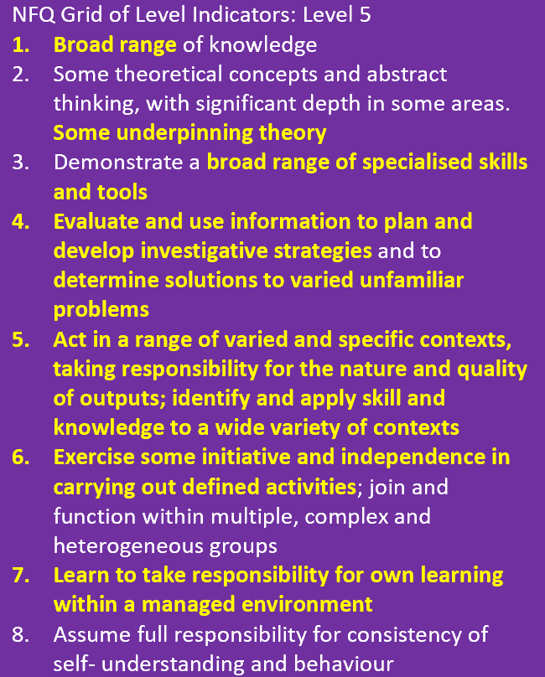
Filling the gaps in MIMLOs
Draft MIMLOs | Learning Outcomes from QQI Component Specification
1. Describe a broad range of common uses and features of a word processing application | LO1: Describe a typical word processing application in terms of common uses and features including - text manipulation, document formatting, graphics, tabs, tables, mail merge and label printing
2. Create a broad range of publishable and specific documents using up –to-date software, tools and skills | LO2, LO3, LO4, LO5, LO7, LO8, LO10, LO11, LO12
3. Modify a broad range of documents using up-to-date software to demonstrate a specialised knowledge and use of word processing features, functions and tools | LO2, LO5, LO7, LO9, LO11
4. Apply word processing file management and distribution features using appropriate software, skills and tools | LO2, LO6
5. Utilise a word processing application for varied familiar and unfamiliar scenarios while producing quality outputs | LO13: Improve personal performance by using additional resources such as the help facility to solve familiar and unfamiliar word processing problems

Slide 52
Final Draft MIMLOs
MIMLO 1 Describe a broad range of common uses and features of a word processing application
MIMLO 2
Create a broad range of publishable and specific documents using up–to-date software, tools and skills
MIMLO 3
Modify a broad range of documents using up-to-date software to demonstrate a specialised knowledge and use of word processing features, functions and tools
MIMLO 4
Apply word processing file management and distribution features using appropriate software, skills and tools
MIMLO 5 Utilise a word processing application for varied and unfamiliar scenarios while producing quality outputs
Text

Slide 53
Is the verb in the MIMLO consistent with the verbs in the mapped learning outcomes from the award specification
Draft MIMLOs | Learning Outcomes from QQI Component Specification
Create a broad range of publishable and specific documents using up –to-date software, tools and skills | LO2 Identify frequently-used toolbar icons and related functions associated with file handling and text formatting LO3 Create documents applying a range of text processing features including - margins and line spacing, indenting text and paragraphs, borders and shading, numbering and bullets, copying and pasting text, enhancing text LO4 Perform initial document configuration using page setup features to include - headers and footers, page numbering, paper size and orientation LO5 Use a range of proofing tools including - spell check, thesaurus, search and replace LO7 Apply file management facilities, including - creating files and folders, saving files in different formats, copying files an folders, renaming files, accessing file details, finding files using search facility LO8 Create mail merge and labels LO10 Produce a range of different types of documents using common word processing features including - manual text formatting, applying styles, creating tables, inserting and manipulating graphics LO11 Print mailable documents and labels using a range of print features, to include - print preview, single and multiple copies, printing specific pages, selecting parameters and adjusting the appearance and positioning of text and graphics LO12 Use a word processing application to create a file from a document template by performing all required steps including creating and storing the template, entering data, and printing and storing the file appropriately for subsequent retrieval
Text

Slide 54
Is the verb in the MIMLO consistent with the verbs in the mapped learning outcomes from the award specification
Draft MIMLOs | Learning Outcomes from QQI Component Specification
2. Modify a broad range of documents using up-to-date software to demonstrate a specialised knowledge and use of word processing features, functions and tools | LO2 Identify frequently-used toolbar icons and related functions associated with file handling and text formatting LO5 Use a range of proofing tools including - spell check, thesaurus, search and replace LO7 Apply a range of table features including - creating tables, resizing, merging cells, inserting or deleting columns and rows, aligning text, applying borders and shading to tables and sorting table content LO9 Use mark-up capabilities to make track changes to documents LO11 Print mailable documents and labels using a range of print features, to include - print preview, single and multiple copies, printing specific pages, selecting parameters and adjusting the appearance and positioning of text and graphics
Text

Slide 55
Is the verb in the MIMLO consistent with the verbs in the mapped learning outcomes from the award specification
Draft MIMLOs | Learning Outcomes from QQI Component Specification
3. Apply word processing file management and distribution features using appropriate software, skills and tools | LO2 Identify frequently-used toolbar icons and related functions associated with file handling and text formatting LO6 Apply file management facilities, including - creating files and folders, saving files in different formats, copying files an folders, renaming files, accessing file details, finding files using search facility
Text

Slide 56
Case Study : Developing MIMLOs
What worked… | What did not work
Writing a module that we had extensive expertise in Really focusing on the purpose of the award, the title and the credit value Starting by drafting broad outcomes that we felt were important Drawing on the information in the NFQ grid of level indicators Mapping to make sure we were on the right track Accepting that the outcomes won’t be perfect on the first draft Using a team approach - brainstorming Allowing lots of time – no pressure learning outcomes: having an awareness of them, using them to identify possible themes/content, but not overly focusing on them initially | Trying to develop a module for a subject that we had limited practical experience of Focusing on the learning outcomes from the component specification as a driver for the development of the MIMLOs – it became a rewriting process – time consuming and frustrating

Slide 57
Writing MIMLOs – useful questions to consider
What should learners know and be able to do at the time of module completion?
What will learners have learned, that will still be there and have value, several years after the programme is taught?
What will learners have to do to demonstrate achievement of the MIMLO? Are the MIMLOs assessable?
Have I avoided vague and difficult/impossible to assess verbs in the MIMLOs?
MAPPING
Are all learning outcomes from the award specification(s) mapped to at least one MIMLO?
What teaching, learning and assessment opportunities will/does the module provide for evidencing the MIMLOs?
Useful Resource: https://www.utica.edu/academic/Assessment/new/Blooms%20Taxonomy%20-%20Best.pdf

Slide 58
Useful points to consider:
Are the learning outcomes:
Active – they describe what students will do
Attractive – students want to achieve them
Comprehensible – students know what they mean
Appropriate – to the student’s current goals and career plans
Attainable – most students will mostly meet them, with due effort
Assessable – we can see if they have been achieved
Visible – to relevant stakeholders, including learners
Adapted from Baume (2009) (Baume, D. (2009), Writing and using good learning outcomes. Available from: https://carpentries.github.io/instructor-training/files/papers/baume-learning-outcomes-2009.pdf)

Slide 59
Useful points to consider:
Providers will use the award specifications as a guideline when developing MIMLOs
MIMLOs must be consistent with the purpose and learning outcomes of the CAS component
The assessment information in the component specifications are also guidelines - justification for choice of assessment technique and weighting must be provided in the programme
Every MIMLO must be mapped to at least one teaching, learning and assessment opportunity in the module

Slide 60
Workshop, in your buddy groups…
Decide which approach to use for the development of the MIMLOs
Start the process of either
clustering existing LOs from the CAS specification into themes or topics or
identifying the minimum key knowledge, skills and competence topics a learner should have at the end
Start the mapping process, bearing in mind that the verb in the MIMLO should be representative of and consistent with the verbs in the LOs mapped to that MIMLO.
Is each MIMLO assessible? Think, how can I access that?

Slide 61
Essential reading if developing learning outcomes

Slide 62
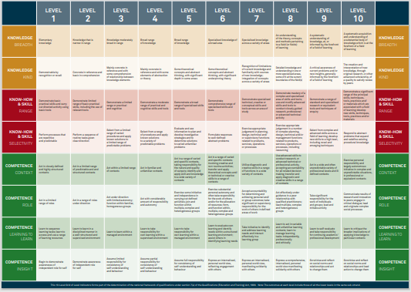
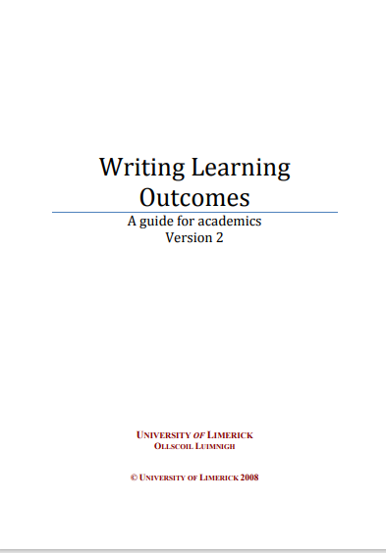
Useful Resources An Introduction to Module Design Writing Assessment Criteria and Performance Indicators: A Handbook
Notes:
Here are some useful resources, these are available on moodle as part of the course resources and they are also hyperlinked.

Slide 63
Text
Module Summative Assessment

Slide 64
Some General Considerations
Universal Design for Learning (UDL)
Criterion-referenced Assessment
Principle of Constructive Alignment

Slide 65
Criterion-referenced Assessment
Summative assessment for QQI awards is criterion-referenced
Learners are assessed and the assessment judgment is made based on whether the learner has reached the required national standards of knowledge, skill and competence for the award.
QQI Quality Assuring Assessment Guidelines for Providers, V2 revised 2018, pg. 5
Criterion-referenced assessments measure performance against a fixed set of criteria or learning standards. (They don’t compare the relative performance of learners)
The assessments apply the same learning standards to all learners

Slide 66
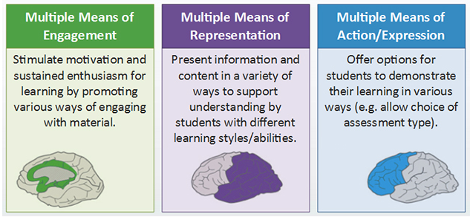
Supporting the Principles of UDL … when designing the teaching, learning and assessment strategies
Find new ways to motivate and engage learners
Present information in a variety of ways
Tap into learners’ interests
Offer appropriate challenges
Allow learners to share new knowledge back in a variety of ways,
For example, for summative assessment:
See learners as partners in the assessment process
Provide choice – e.g. format of evidence
Consider inclusive and flexible options
Text
https://www.ahead.ie/udl-framework

Slide 67
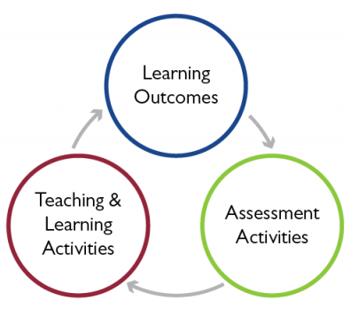
Principle of Constructive Alignment (John Biggs, 2003)
Start with the outcomes we intend learners to learn (MIMLOs), and align teaching/learning activities and assessment to those outcomes
Provides coherence between assessment, teaching strategies and intended learning outcomes
Summative assessment is about how well learners achieve the intended learning outcomes.
Text

Slide 68
http://www.ucdoer.ie/index.php/Using_Biggs'_Model_of_Constructive_Alignment_in_Curriculum_Design/Introduction
A model
of
aligned curriculum

Slide 69
Selecting Assessment Techniques
Some considerations
What assessment technique/s? How many?
What weightings?
Reflective of the requirements of the MIMLOs
What is the rationale for the choice/s
Is it fair?
Will it consider all learners’ needs and characteristics?
Appropriate for the NFQ level
Text
Is it valid?
Will it measure what it is supposed to measure?
Is it authentic?
Will it provide for relevant, meaningful, task-based activities, related to the real world?
Will the selection allow learners demonstrate achievement of ALL MIMLOs?

Slide 70
Selecting Assessment Techniques for Modules
QQI guidelines, 2024:
Set out the technique/s you have chosen “in specific terms” and “provide a very brief rationale for this (50 words or less)”
Some examples:
Learner record / Reflective Diary
Research Project
Assignment – Case Study
Assignment - Business Plan
Assignment – Blog / Vlog
Multiple Choice Examination
Presentation using appropriate software
Portfolio of work
More flexibility now – so choose any assessment technique/s if determined to be the optimum way to assess.
Technique/s used to date in FET programmes: Assignment; Collection of Work; Examination – Theory, Practical, etc.; Learner Record; Project; Skills Demonstration
Text

Slide 71
Assessment Techniques from QQI CAS Minor Award Word Processing 5N1358
- Assignment 20%
- Examination - Practical 80%
Assessment Technique for Module:
Collection of Work 100%
Sample
Mapping of MIMLOs to Assessment Technique/s (including sub-tasks)
MIMLOs | Assessment Technique and Sub-Tasks
1. Describe a broad range of common uses and features of a word processing application | Collection of Work Part 1: Document Production
2. Create a broad range of publishable and specific documents using up–to-date software, tools and skills | Collection of Work Part 1: Document Production
3. Modify a broad range of documents using up-to-date software to demonstrate a specialised knowledge and use of word processing features, functions and tools | Collection of Work Part 2: Modification of Documents
4. Apply word processing file management and distribution features using appropriate software, skills and tools | Collection of Work Part 1: Document Production Part 2: Modification of Documents Part 3: Scenario set for Learners by Assessor
5. Utilise a word processing application for varied and unfamiliar scenarios while producing quality outputs | Collection of Work Part 3: Scenario set for Learners by Assessor
Text

Slide 72
Assessment Guidelines for Assessors Some Considerations
Context/s
Where the assessment will take place – location/what situation/what equipment or facilities?
What must be incorporated for each technique and sub-task/s, if appropriate (linked to MIMLOs)
Time
Duration assigned to learners to complete the individual assessment task/s
Scheduling of the assessment
Text
Format and presentation of the learner work (e.g. written, oral, video, practical, performance-based, presentation-based, etc. Is there a guide word count, etc.)
Consider UDL principles – providing choice, inclusive and flexible options, etc.
Whether the assessment can be carried out by a group or has it to be individual.
NB Individuals undertaking group-based assessment tasks are assessed as individuals – criterion-referenced assessment
Any other relevant information – resources, materials, permissions required for the assessment
Extent and range of evidence required

Slide 73
Workshop, in your buddy groups …
Select appropriate assessment technique/s for your module
Map the draft module learning outcomes to the selected assessment technique/s
Tease out some initial guidelines for assessors to assist with the development of briefs/exams.

Slide 74
Assessment Criteria
Assessment criteria are the basis by which a learner’s performance in an assessment technique/task will be judged.
An assessment criterion is a characteristic by which the quality of the assessment task will be judged
Generally between 3 and 5 criteria per assessment technique/task
Start by thinking about
What aspects of the learner evidence will make it successful
What learners need to know and be able to do to pass the assessment
Example:
Key aspects for judging a learner's reflective journal might be:
Described experiences
Analysed experiences
Identified what learning occurred
Identified or took future action/s

Slide 75
Devising Assessment Criteria
Use a consistent (past) tense across all modules, for example,
Clearly identified … OR clear identification of …
Critically evaluated… OR critical evaluation of…
Drew appropriate conclusions on … OR appropriate conclusions drawn on
Weightings/marks should be assigned for all elements of what the learner is meant to know, be able to do and understand (linked to MIMLOs)
Consider the relative importance of the criteria and decide how to weight them
Consider the importance of the concepts, the significance of the MIMLO/s to the module and the learner’s workload.
Include an indication of total marks allocated and how they subdivide along broad categories of the assessment criteria, e.g.:
Total of 100 marks: 50 for … , 20 for … , 20 for …. , 10 for …

Slide 76
Example of Assessment Criteria for: Reflective Journal (50%)
Mapped MIMLO: Engage in critical reflection to support the development of professional practice
How might the criteria be weighted? Possibly as follows:
For the required number of personal activities/experiences
Provided detailed descriptions of activities/experiences
Analysed the experiences to include reactions, personal context, impact/implications
Clearly identified key lessons learnt
Recommended potential future actions/changes
Text
1 | 10 marks
2 | 20 marks
3 | 10 marks
4 | 10 marks

Slide 77
Assessment criteria should:
Provide guidance for assessors when designing their assessment instruments and developing marking schemes
Describe only what is essential, to demonstrate that the learner has achieved the learning outcome/s
Avoid including procedures and methods in the criteria, unless they are reflective of the learning outcome/s.
Reflect the specifics in the assessment guidelines per assessment technique
Describe the context for the actions/activities, where appropriate (e.g., prepared a business plan for a specific client)
Be as clear, specific and precise as possible
Help learners
recognize what is important and valued in the module curriculum.
focus their efforts on key learning outcomes
evaluate their own performance through self-assessment and reflection.
Text

Slide 78
Workshop, in your buddy groups …
For at least one of the selected assessment techniques draft assessment criteria
N.B. Refer to the aligned MIMLOs and the draft assessment guidelines

Slide 79
Using rubrics to support assessment judgements

Slide 80
Sample Template for an Assessment Rubric
 |  | Level of Achievement – Performance Descriptors
 |  | Unsuccessful < 50% Failed to meet the threshold level of achievement | Pass 50% - 64% Reached the minimum level of achievement | Merit 65% - 79% Reached a high level of achievement | Distinction ≥ 80% Reached a very high to outstanding level of achievement
Criteria

Slide 81
Questions?
FOLLOW UP EMAIL/ CONTACT INFORMATION

